Slide 1


Slide 2
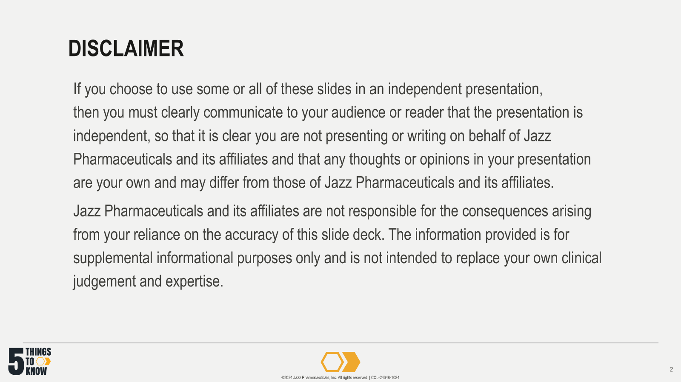

Slide 3


Slide 4
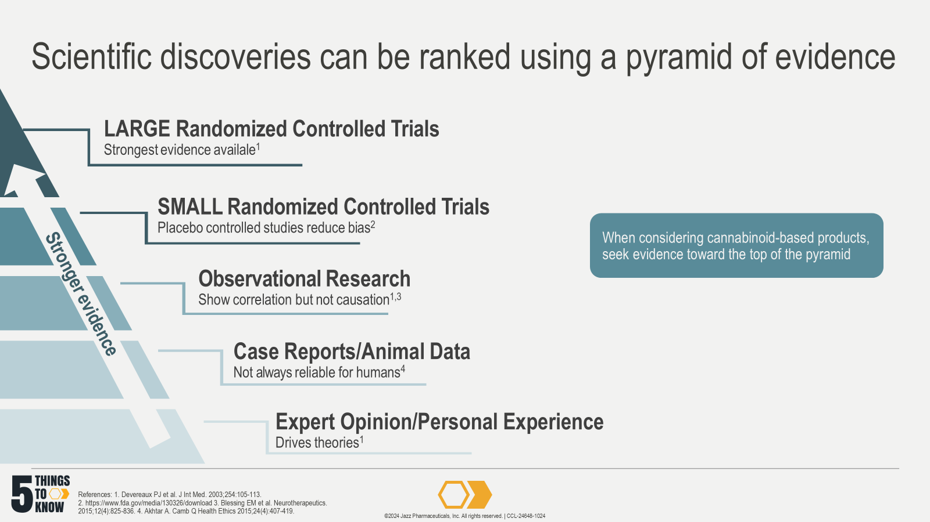
Notes:
References:
Devereaux PJ, Yusuf S. The evolution of the randomized controlled trial and its role in evidence-based decision making. J Intern Med. Aug 2003;254(2):105-13. doi:10.1046/j.1365-2796.2003.01201.x
US Food and Drug Administration. Placebos and Blinding in Randomized Controlled Cancer Trials for Drug and Biological Products. 2019. Accessed Oct 1, 2024. https://www.fda.gov/media/130326/download
Blessing EM, Steenkamp MM, Manzanares J, Marmar CR. Cannabidiol as a Potential Treatment for Anxiety Disorders. Neurotherapeutics. Oct 2015;12(4):825-36. doi:10.1007/s13311-015-0387-1
Akhtar A. The flaws and human harms of animal experimentation. Camb Q Health Ethics. Oct 2015;24(4):407-19. doi:10.1017/S0963180115000079

Slide 5
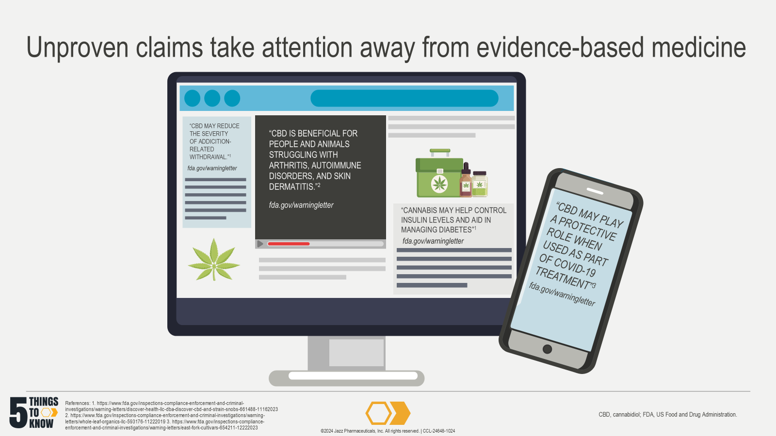
Notes:
References:
US Food and Drug Administration. Warning Letter Discover Health, LLC d/b/a Discover CBD and Strain Snobs. Updated November 21, 2023. Accessed July 9, 2024. https://www.fda.gov/inspections-compliance-enforcement-and-criminal-investigations/warning-letters/discover-health-llc-dba-discover-cbd-and-strain-snobs-661488-11162023
US Food and Drug Administration. Warning Letter Whole Leaf Organics, LLC. Accessed March 16, 2021. https://www.fda.gov/inspections-compliance-enforcement-and-criminal-investigations/warning-letters/whole-leaf-organics-llc-593176-11222019
US Food and Drug Administration. Warning Letter East Fork Cultivars. Updated December 26, 2023. Accessed July 9, 2024. https://www.fda.gov/inspections-compliance-enforcement-and-criminal-investigations/warning-letters/east-fork-cultivars-654211-12222023

Slide 6
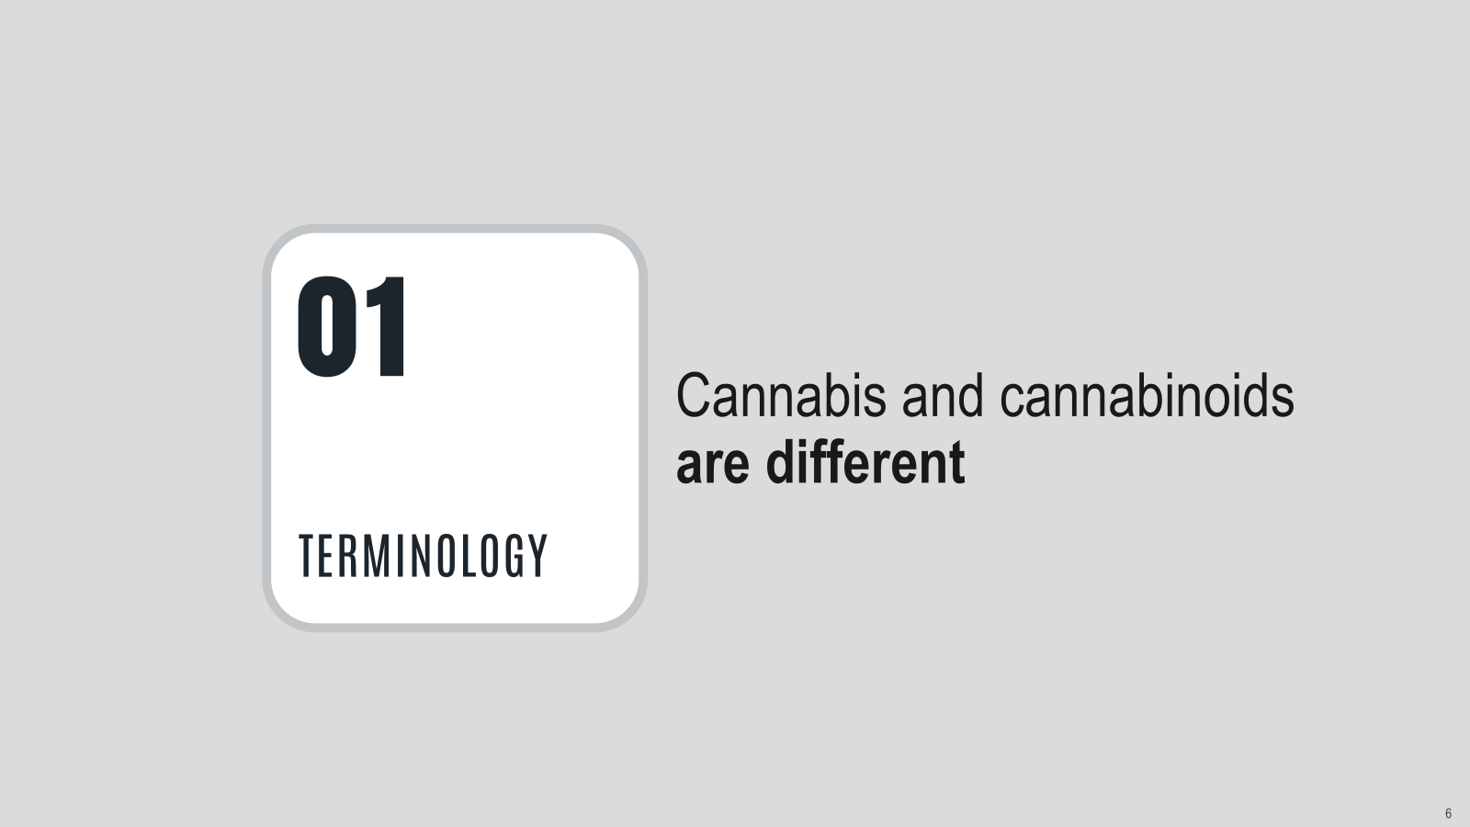

Slide 7
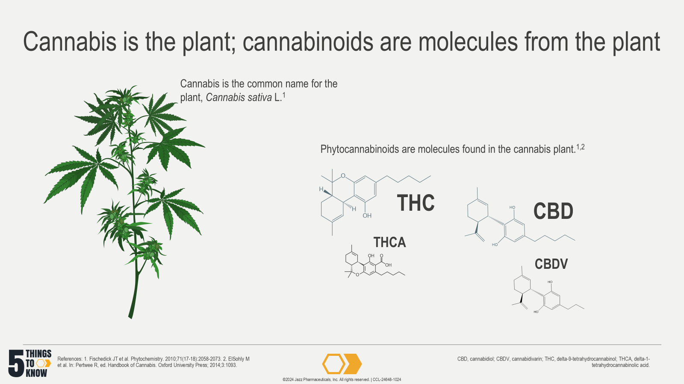
Notes:
References:
Fischedick JT, Hazekamp A, Erkelens T, et al. Metabolic ﬁngerprinting of Cannabis sativa L., cannabinoids and terpenoids for chemotaxonomic and drug standardization purposes. Phytochemistry. 2010;71:2058-2073. doi: 0.1016/j.phytochem.2010.10.001
ElSohly M, Gul W. Constituents of Cannabis sativa. In: Pertwee R, ed. Handbook of Cannabis. Oxford University Press; 2014;3:1093.

Slide 8
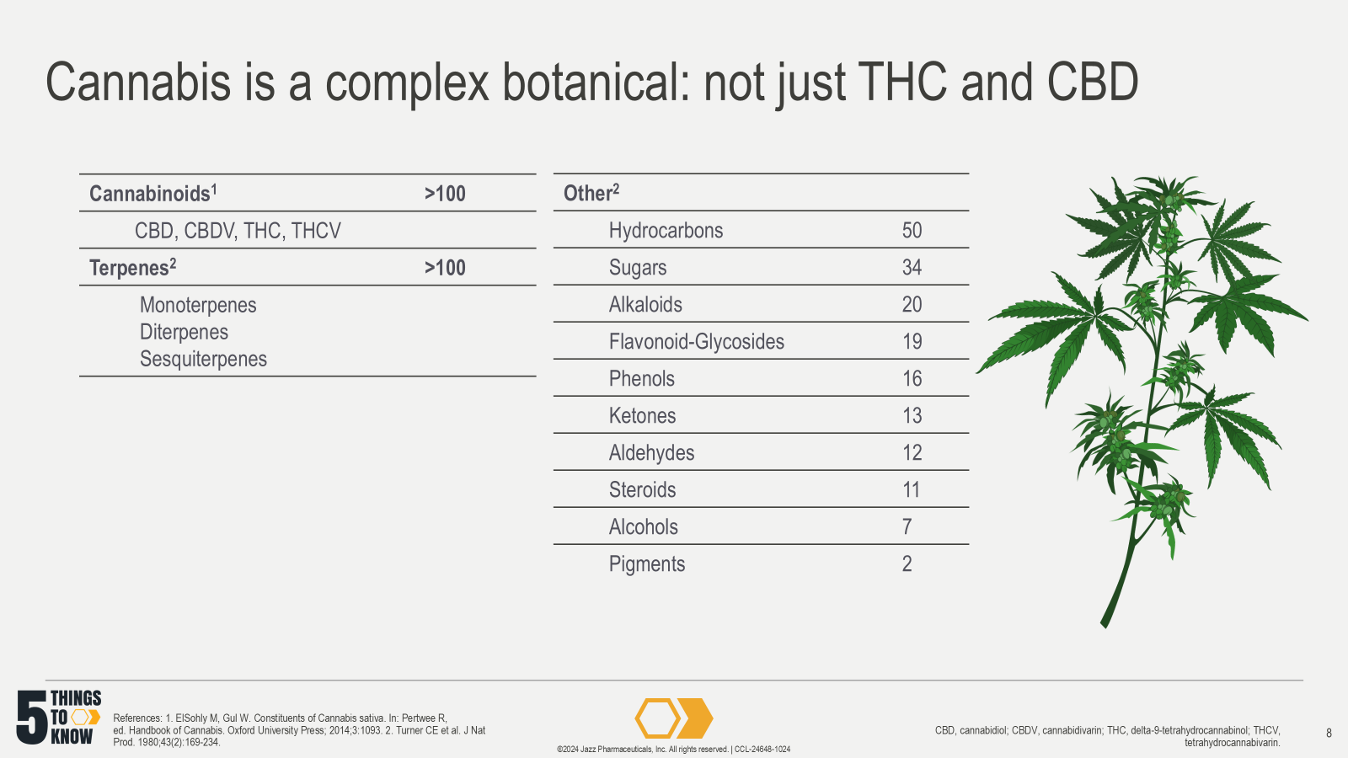
Notes:
References:
ElSohly M, Gul W. Constituents of Cannabis sativa. In: Pertwee R, ed. Handbook of Cannabis. Oxford University Press; 2014;3:1093.
Turner CE, Elsohly MA, Boeren EG. Constituents of Cannabis sativa L. XVII. A review of the natural constituents. J Nat Prod. 1980;43(2):169-234.

Slide 9
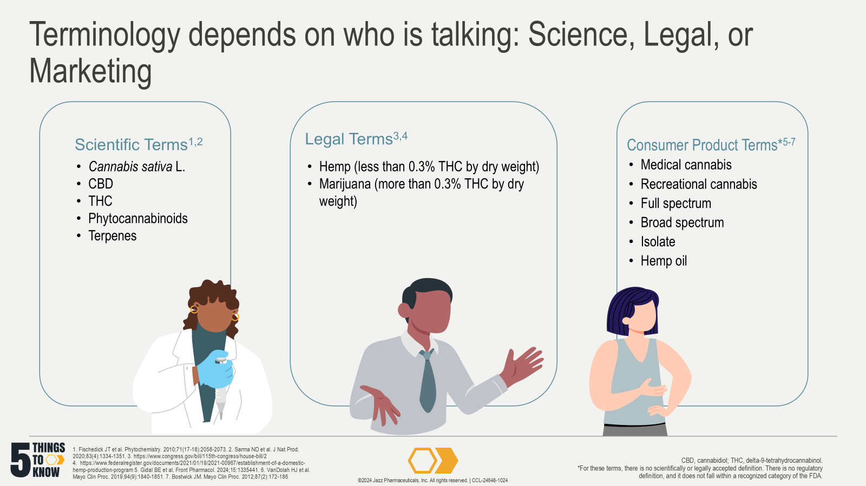
Notes:
References:
Fischedick JT, Hazekamp A, Erkelens T, Choi YH, Verpoorte R. Metabolic fingerprinting of Cannabis sativa L., cannabinoids and terpenoids for chemotaxonomic and drug standardization purposes. Phytochemistry. 2010;71(17-18):2058-2073. doi:10.1016/j.phytochem.2010.10.001
Sarma ND, Waye A, ElSohly MA, et al. Cannabis Inflorescence for Medical Purposes: USP Considerations for Quality Attributes. J Nat Prod. 2020;83(4):1334-1351. doi:10.1021/acs.jnatprod.9b01200
H.R.2 - 115th Congress (2017-2018). Agriculture Improvement Act of 2018. Accessed 3 Dec 2021. https://www.congress.gov/bill/115th-congress/house-bill/2.
Department of Agriculture (USDA). Establishment of a Domestic Hemp Production Program, 7 CFR §990 (2021). Accessed 3 Dec 2021. https://www.federalregister.gov/documents/2021/01/19/2021-00967/establishment-of-a-domestic-hemp-production-program.
Gidal BE, Vandrey R, Wallin C, et al. Product labeling accuracy and contamination analysis of commercially available cannabidiol product samples. Front Pharmacol. 2024;15:1335441.
VanDolah HJ, Bauer BA, Mauck KF. Clinicians' Guide to Cannabidiol and Hemp Oils. Mayo Clin Proc. 2019;94(9):1840-1851.
Bostwick JM. Blurred boundaries: the therapeutics and politics of medical marijuana. Mayo Clin Proc. 2012;87(2):172-186. doi:10.1016/j.mayocp.2011.10.003

Slide 10
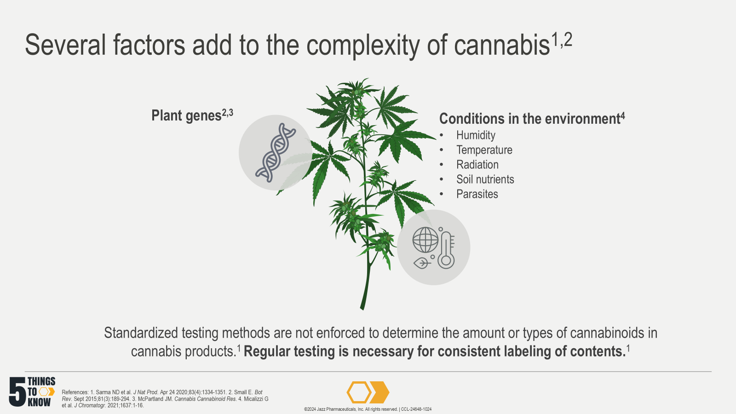
Notes:
References:
Sarma ND, Waye A, ElSohly MA, et al. Cannabis Inflorescence for Medical Purposes: USP Considerations for Quality Attributes. J Nat Prod. Apr 24 2020;83(4):1334-1351. doi: 10.1021/acs.jnatprod.9b01200
Small E. Evolution and Classification of Cannabis sativa (Marijuana, Hemp) in Relation to Human Utilization. Bot Rev. Sept 2015;81(3):189-294. doi:10.1007/s12229-015-9157-3
McPartland JM. Cannabis Systematics at the Levels of Family, Genus, and Species. Cannabis Cannabinoid Res. 2018;3(1):203-212. doi:10.1089/can.2018.0039
Micalizzi G, Vento F, Alibrando F, Donnarumma D, Dugo P, Mondello L. Cannabis Sativa L.: a comprehensive review on the analytical methodologies for cannabinoids and terpenes characterization. J Chromatogr A. Jan 25 2021;1637:461864. doi: 10.1016/j.chroma.2020.461864

Slide 11
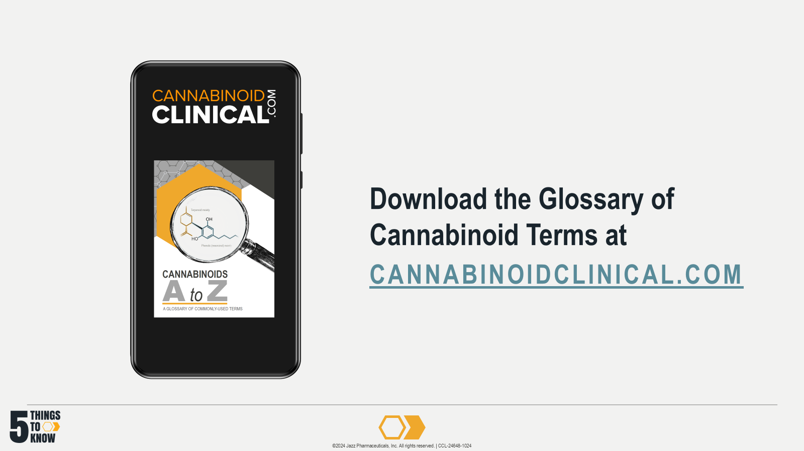

Slide 12
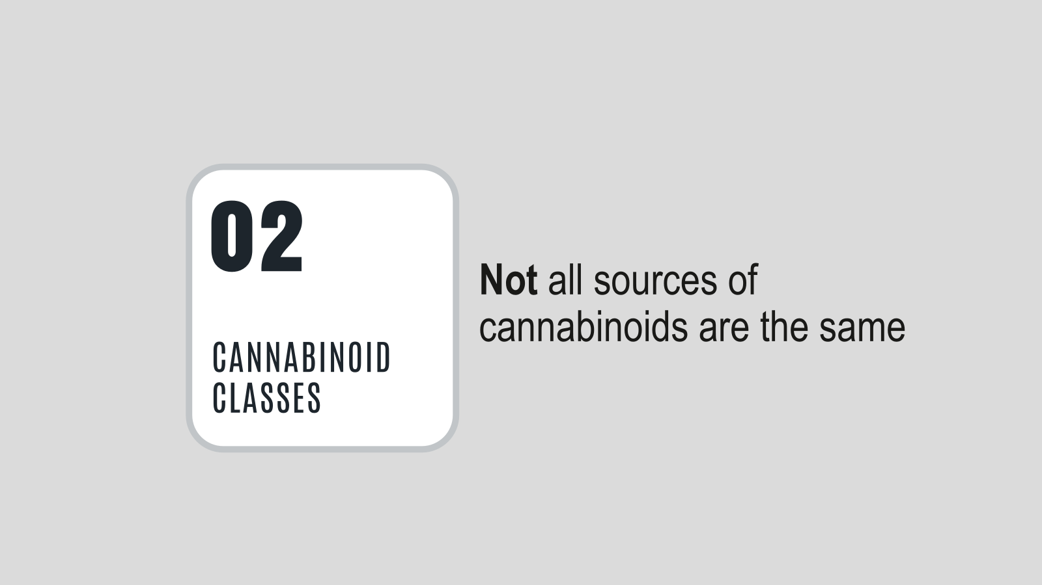

Slide 13
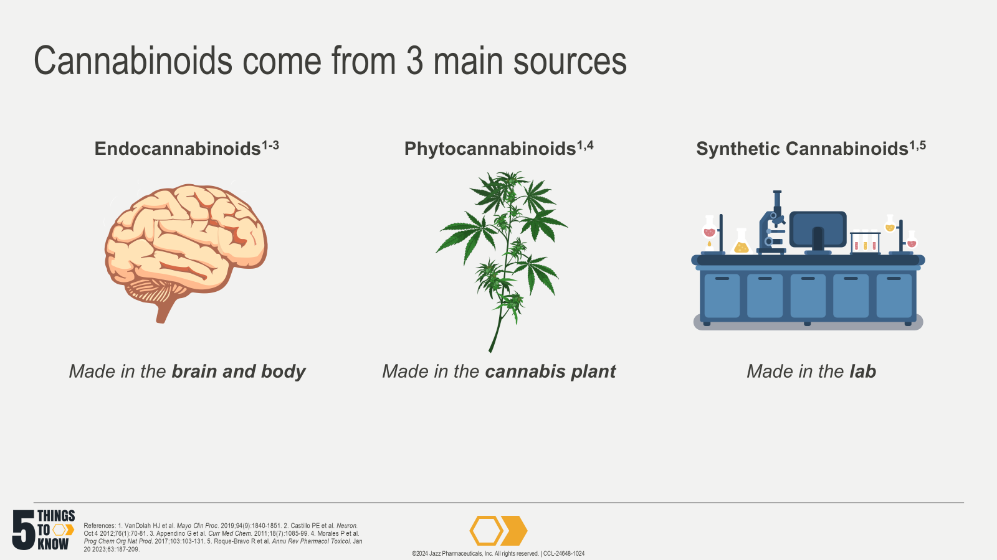
Notes:
Notes:
AEA and 2-AG are the classic endocannabinoids^{3,6}
Phytocannabinoids are plant derived and include CBD and THC and over 100 others⁷
Synthetic cannabinoids are lab derived and include FDA-approved drugs like dronabinol and nabilone. There are also synthetic cannabinoids that are used illicitly^{5,8-11}
References:
VanDolah HJ, Bauer BA, Mauck KF. Clinicians' Guide to Cannabidiol and Hemp Oils. Mayo Clin Proc. 2019;94(9):1840-1851. doi:10.1016/j.mayocp.2019.01.003
Castillo PE, Younts TJ, Chavez AE, Hashimotodani Y. Endocannabinoid signaling and synaptic function. Neuron. Oct 4 2012;76(1):70-81. doi:10.1016/j.neuron.2012.09.020
Appendino G, Chianese G, Taglialatela-Scafati O. Cannabinoids: occurrence and medicinal chemistry. Curr Med Chem. 2011;18(7):1085-99. doi:10.2174/092986711794940888
Morales P, Hurst DP, Reggio PH. Molecular Targets of the Phytocannabinoids: A Complex Picture. Prog Chem Org Nat Prod. 2017;103:103-131. doi:10.1007/978-3-319-45541-9_4
Roque-Bravo R, Silva RS, Malheiro RF, et al. Synthetic Cannabinoids: A Pharmacological and Toxicological Overview. Annu Rev Pharmacol Toxicol. Jan 20 2023;63:187-209. doi:10.1146/annurev-pharmtox-031122-113758
Mack A, Joy J. Marijuana as Medicine?: The Science Beyond the Controversy. Washington (DC): National Academies Press (US); 2000. [Notes only]
ElSohly M, Gul W. Constituents of Cannabis sativa. In: Pertwee R, ed. Handbook of Cannabis. Oxford University Press; 2014;3:1093. [Notes only]
Marinol® (dronabinol) capsules, for oral use [prescribing information]. North Chicago, IL: AbbVie Inc. https://dailymed.nlm.nih.gov/dailymed/drugInfo.cfm?setid=d0efeeec-640d-43c3-8f0a-d31324a11c68 [Notes only]
Syndros® (dronabinol) oral solution [prescribing information]. Chandler, AZ: Benuvia Therapeutics Inc. https://dailymed.nlm.nih.gov/dailymed/drugInfo.cfm?setid=a7801c70-995d-46a2-91ee-141ef427c6b5 [Notes only]
Cesamet® (nabilone) capsules [prescribing information]. Bridgewater, NJ: Bausch Health US LLC. https://dailymed.nlm.nih.gov/dailymed/drugInfo.cfm?setid=83c7ac15-ece9-47de-b83c-d575544fa449 [Notes only]
Psychoyos D, Vinod KY. Marijuana, Spice 'herbal high', and early neural development: implications for rescheduling and legalization. Drug Test Anal. 2013;5(1):27-45. doi:10.1002/dta.1390 [Notes only]

Slide 14
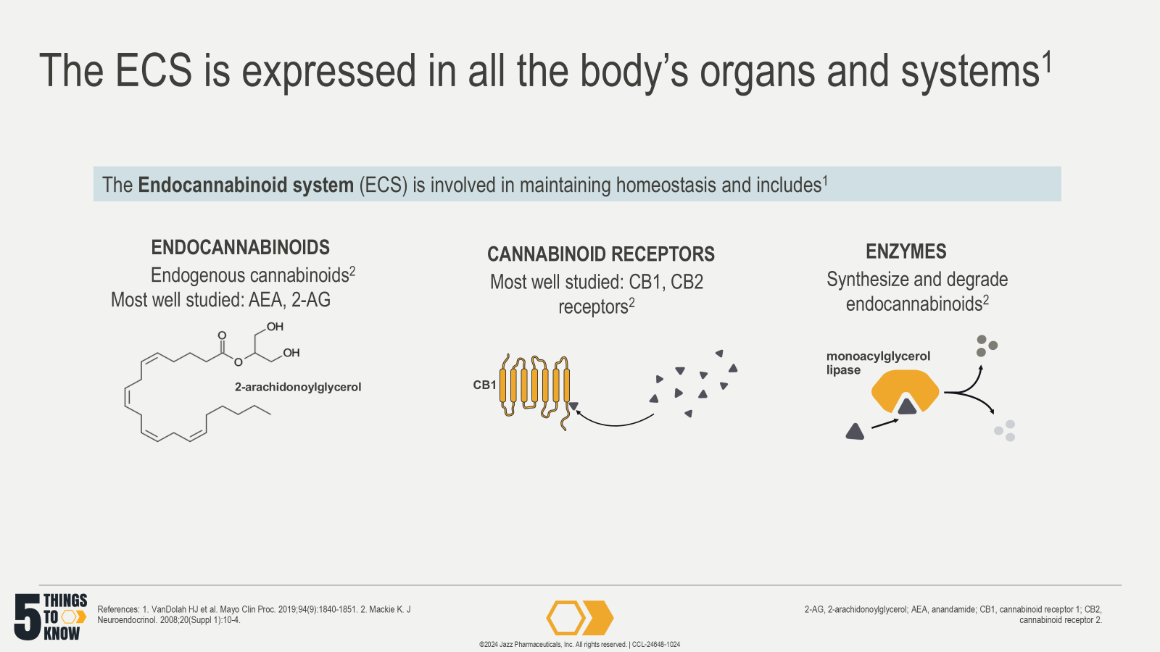
Notes:
References:
VanDolah HJ, Bauer BA, Mauck KF. Clinicians’ guide to cannabidiol and hemp oils. Mayo Clin Proc. 2019;94(9):1840-1851.
Mackie K. Cannabinoid receptors: where they are and what they do. J Neuroendocrinol. 2008 May;20 Suppl 1:10-4. doi: 10.1111/j.1365-2826.2008.01671.x. PMID: 18426493.

Slide 15
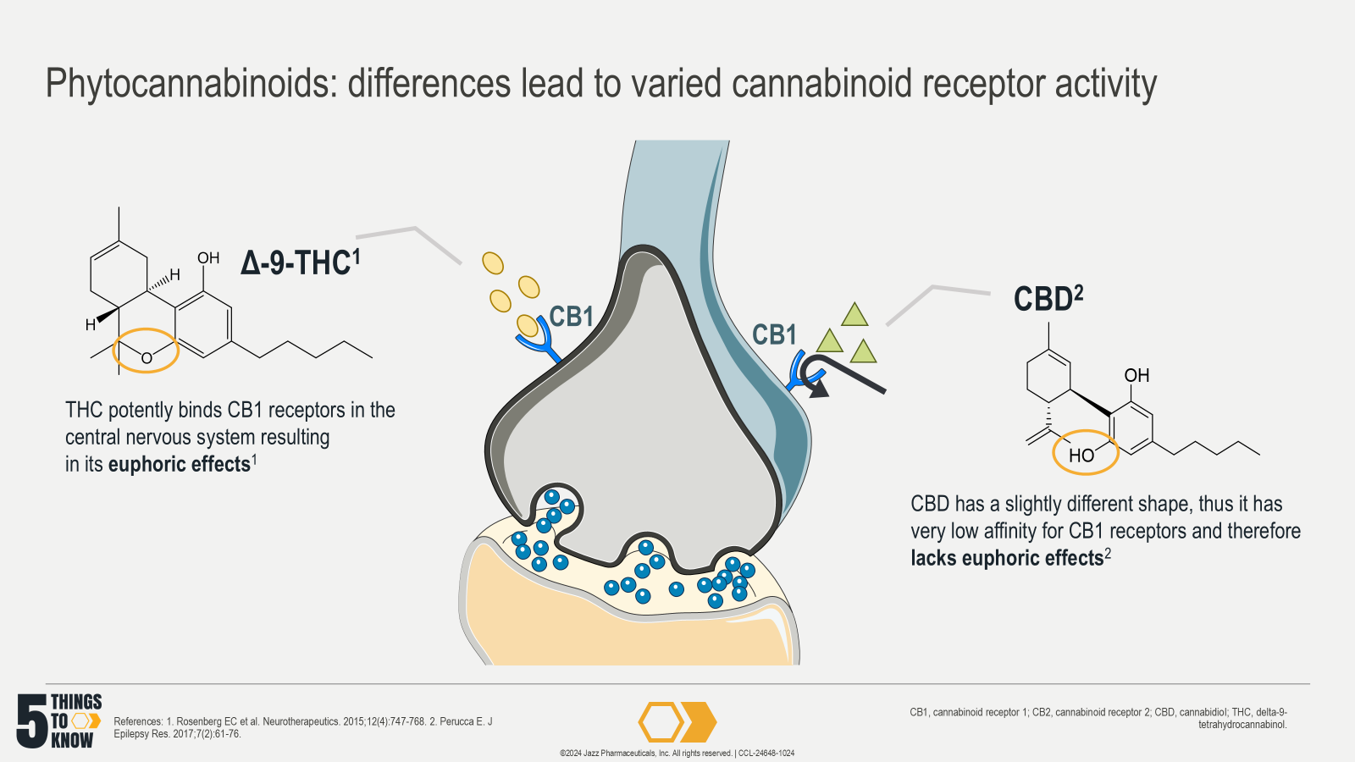
Notes:
References:
Rosenberg EC, Tsien RW, Whalley BJ, Devinsky O. Cannabinoids and Epilepsy. Neurotherapeutics. 2015;12(4):747-768. doi:10.1007/s13311-015-0375-5
Perucca E. Cannabinoids in the Treatment of Epilepsy: Hard Evidence at Last?. J Epilepsy Res. 2017;7(2):61-76. doi:10.14581/jer.17012

Slide 16
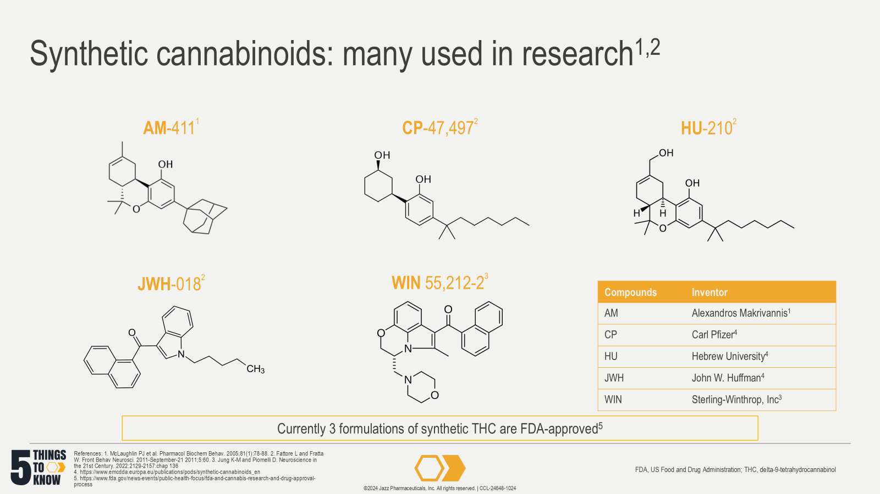
Notes:
Notes:
Synthetic cannabinoids have unique chemical structures but also a unique naming culture based upon the inventor
Shown here are 5 examples of synthetic cannabinoids developed for research.
References:
McLaughlin PJ, Lu D, Winston KM, et al. Behavioral effects of the novel cannabinoid full agonist AM 411. Pharmacol Biochem Behav. May 2005;81(1):78-88. doi:10.1016/j.pbb.2005.02.005
Fattore L, Fratta W. Beyond THC: The New Generation of Cannabinoid Designer Drugs. Review. Front Behav Neurosci. 2011-September-21 2011;5:60. doi:10.3389/fnbeh.2011.00060
Jung K-M, Piomelli D. Cannabinoids and Endocannabinoids. In: Pfaff DW, Volkow ND, Rubenstein JL, eds. Neuroscience in the 21st Century. Springer International Publishing; 2022:2129-2157:chap 136.
European Monitoring Centre for Drugs and Drug Addiction. Perspectives on Drugs: Synthetic Cannabinoids in Europe. 2017. Accessed Oct 18, 2022. https://www.emcdda.europa.eu/publications/pods/synthetic-cannabinoids_en
US Food and Drug Administration. FDA and Cannabis: Research and Drug Approval Process. Updated Feb 24, 2023. Accessed Sept 2, 2024. https://www.fda.gov/news-events/public-health-focus/fda-and-cannabis-research-and-drug-approval-process

Slide 17
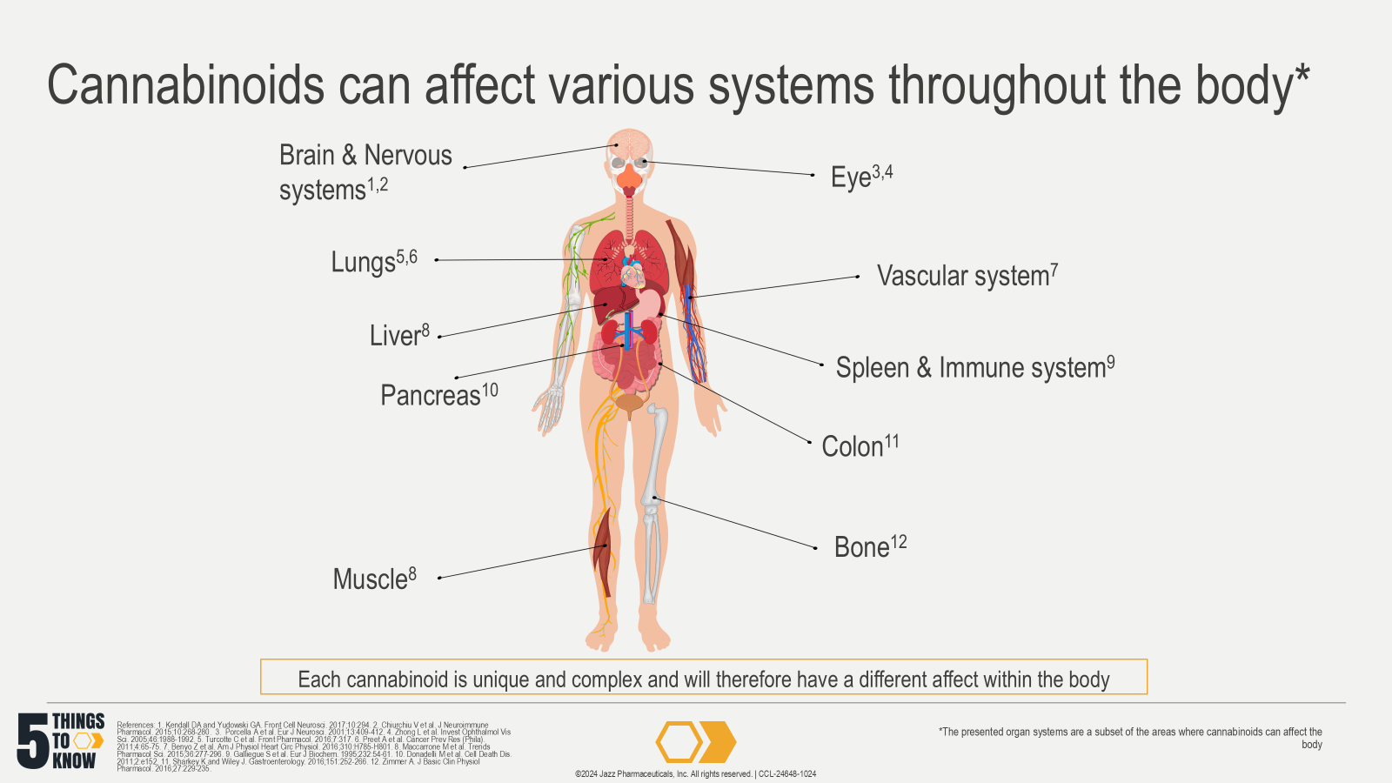
Notes:
References:
Kendall DA, Yudowski GA. Cannabinoid Receptors in the Central Nervous System: Their Signaling and Roles in Disease. Front Cell Neurosci. 2017;10:294. Published 2017 Jan 4. doi:10.3389/fncel.2016.00294
Chiurchiù V, Leuti A, Maccarrone M. Cannabinoid Signaling and Neuroinflammatory Diseases: A Melting pot for the Regulation of Brain Immune Responses. J Neuroimmune Pharmacol. 2015;10(2):268-280. doi:10.1007/s11481-015-9584-2
Porcella A, Maxia C, Gessa GL, Pani L. The synthetic cannabinoid WIN55212-2 decreases the intraocular pressure in human glaucoma resistant to conventional therapies. Eur J Neurosci. 2001;13(2):409-412. doi:10.1046/j.0953-816x.2000.01401.x
Zhong L, Geng L, Njie Y, Feng W, Song ZH. CB2 cannabinoid receptors in trabecular meshwork cells mediate JWH015-induced enhancement of aqueous humor outflow facility. Invest Ophthalmol Vis Sci. 2005;46(6):1988-1992. doi:10.1167/iovs.04-0651
Turcotte C, Blanchet MR, Laviolette M, Flamand N. Impact of Cannabis, Cannabinoids, and Endocannabinoids in the Lungs. Front Pharmacol. 2016;7:317. Published 2016 Sep 15. doi:10.3389/fphar.2016.00317
Preet A, Qamri Z, Nasser MW, et al. Cannabinoid receptors, CB1 and CB2, as novel targets for inhibition of non-small cell lung cancer growth and metastasis. Cancer Prev Res (Phila). 2011;4(1):65-75. doi:10.1158/1940-6207.CAPR-10-0181
Benyó Z, Ruisanchez É, Leszl-Ishiguro M, Sándor P, Pacher P. Endocannabinoids in cerebrovascular regulation. Am J Physiol Heart Circ Physiol. 2016;310(7):H785-H801. doi:10.1152/ajpheart.00571.2015
Maccarrone M, Bab I, Bíró T, et al. Endocannabinoid signaling at the periphery: 50 years after THC. Trends Pharmacol Sci. 2015;36(5):277-296. doi:10.1016/j.tips.2015.02.008
Galiègue S, Mary S, Marchand J, et al. Expression of central and peripheral cannabinoid receptors in human immune tissues and leukocyte subpopulations. Eur J Biochem. 1995;232(1):54-61. doi:10.1111/j.1432-1033.1995.tb20780.x
Donadelli M, Dando I, Zaniboni T, et al. Gemcitabine/cannabinoid combination triggers autophagy in pancreatic cancer cells through a ROS-mediated mechanism. Cell Death Dis. 2011;2(4):e152. Published 2011 Apr 28. doi:10.1038/cddis.2011.36
Sharkey KA, Wiley JW. The Role of the Endocannabinoid System in the Brain-Gut Axis. Gastroenterology. 2016;151(2):252-266. doi:10.1053/j.gastro.2016.04.015
Zimmer A. A collaboration investigating endocannabinoid signalling in brain and bone. J Basic Clin Physiol Pharmacol. 2016;27(3):229-235. doi:10.1515/jbcpp-2015-0125

Slide 18
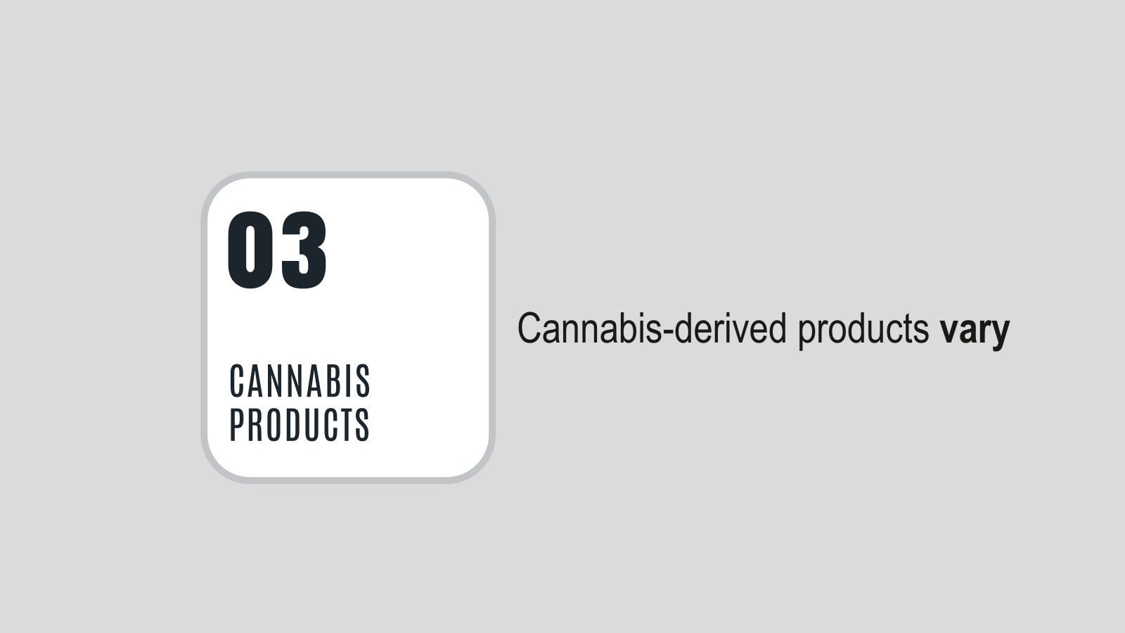

Slide 19
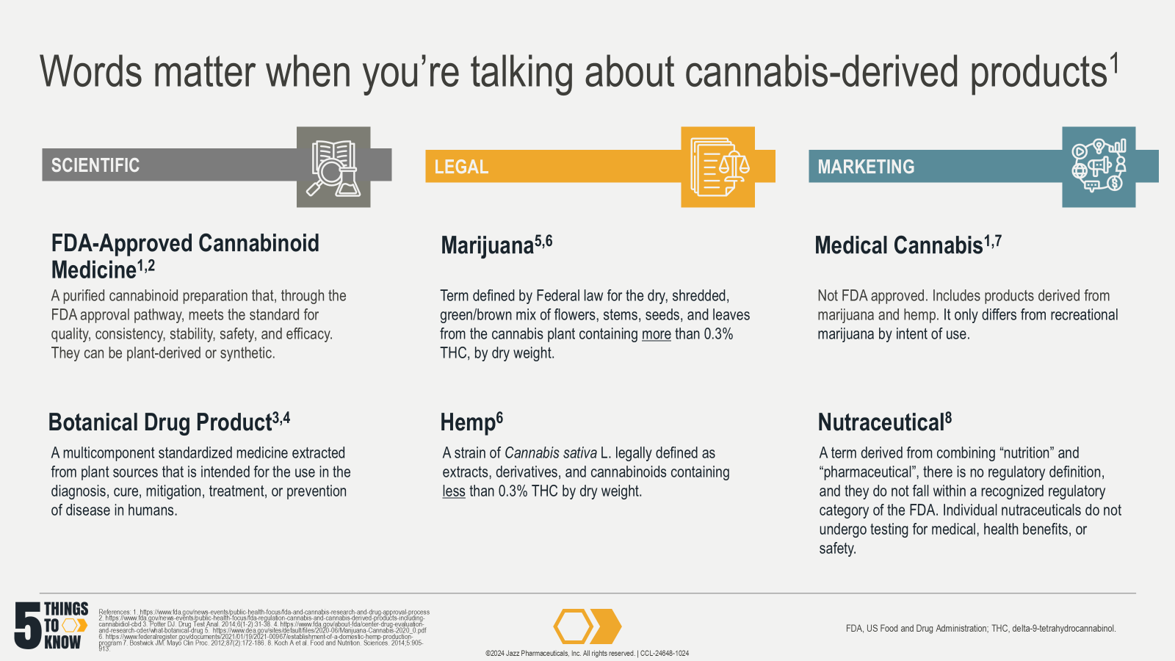
Notes:
References:
US Food and Drug Administration. FDA and Cannabis: Research and Drug Approval Process. Updated Feb 24, 2023. Accessed Sept 2, 2024. https://www.fda.gov/news-events/public-health-focus/fda-and-cannabis-research-and-drug-approval-process.
US Food and Drug Administration. FDA Regulation of Cannabis and Cannabis-derived Products. Updated July 16, 2024. Accessed Oct 2, 2024. https://www.fda.gov/news-events/public-health-focus/fda-regulation-cannabis-and-cannabis-derived-products-including-cannabidiol-cbd
Potter DJ. A review of the cultivation and processing of cannabis (Cannabis sativa L.) for production of prescription medicines in the UK. Drug Test Anal. Jan-Feb 2014;6(1-2):31-8. doi:10.1002/dta.1531.
US Food and Drug Administration. What is a Botanical Drug? FDA.gov. Updated Aug 29, 2024. Accessed Oct 2, 2024. https://www.fda.gov/about-fda/center-drug-evaluation-and-research-cder/what-botanical-drug.
US Drug Enforcement Administration. Drug Fact Sheet: Marijuana/Cannabis. April 2020. Accessed Oct 2, 2024. https://www.dea.gov/sites/default/files/2020-06/Marijuana-Cannabis-2020_0.pdf
Department of Agriculture (USDA). Establishment of a Domestic Hemp Production Program, 7 CFR §990 (2021). Accessed 3 Dec 2021. https://www.federalregister.gov/documents/2021/01/19/2021-00967/establishment-of-a-domestic-hemp-production-program.
Bostwick JM. Blurred boundaries: the therapeutics and politics of medical marijuana. Mayo Clin Proc. Feb 2012;87(2):172-86. doi:10.1016/j.mayocp.2011.10.003.
Koch, A. , Brandenburger, S. , Türpe, S. and Birringer, M. The need for a legal distinction of nutraceuticals. Food and Nutrition Sciences. 2014;5:905-913. doi:10.4236/fns.2014.510100

Slide 20
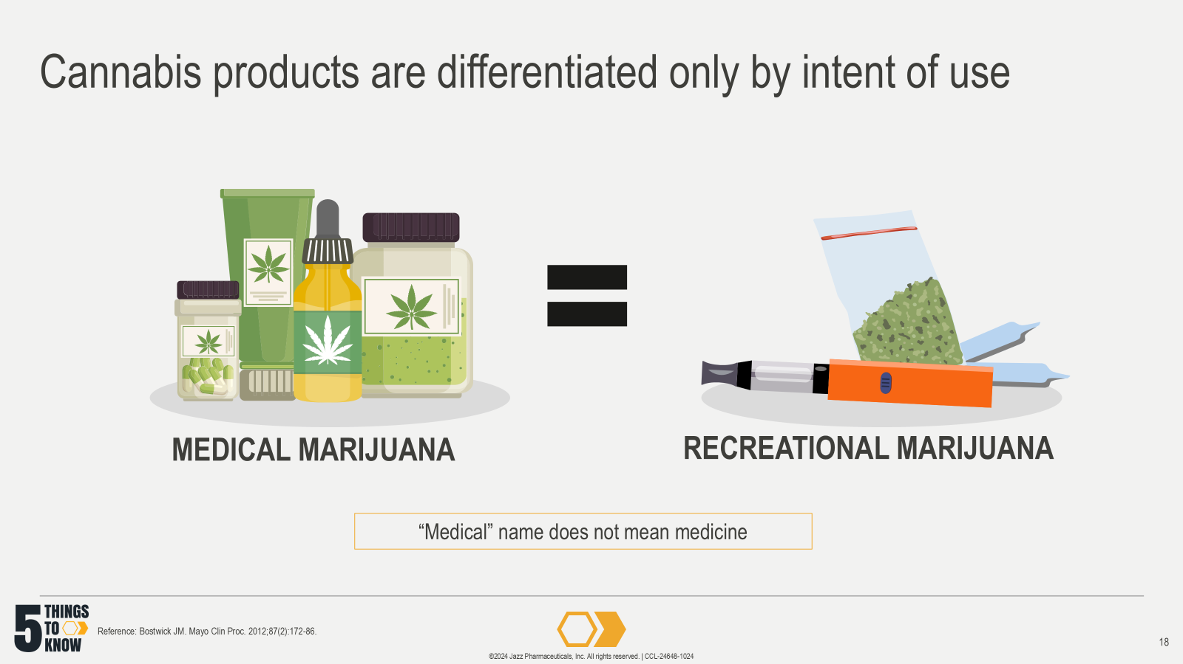
Notes:
Notes:
Two very commonly discussed cannabis-derived products are medical marijuana, also sometimes called medical cannabis; and recreational marijuana, also sometimes called adult-use cannabis
Medical cannabis is sold to consumers who have been certified or a recommendation by a healthcare provider to have a qualified condition²
Recreational cannabis is used to induce pleasure, euphoria or relaxation, and to enhance sociability³
What’s important to note is that these two marketing terms are essentially the same products, just differentiated by intent of use¹
References:
Bostwick JM. Blurred boundaries: the therapeutics and politics of medical marijuana. Mayo Clin Proc. 2012;87(2):172-186. doi:10.1016/j.mayocp.2011.10.003
Slawek DE, Althouse AD, Feldman R, et al. Cannabis dispensary staff approaches to counseling on potential contraindications to cannabis use: insights from a national self-report survey. BMC Prim Care. Jul 14 2023;24(1):145. doi:10.1186/s12875-023-02095-5 [Notes only]
Hall W. Sought-After Effects, Adverse Effects, Designer Drugs, and Harm Minimization. In: Pertwee R, ed. Handbook of Cannabis. Oxford University Press; 2014:part 6. [Notes only]

Slide 21
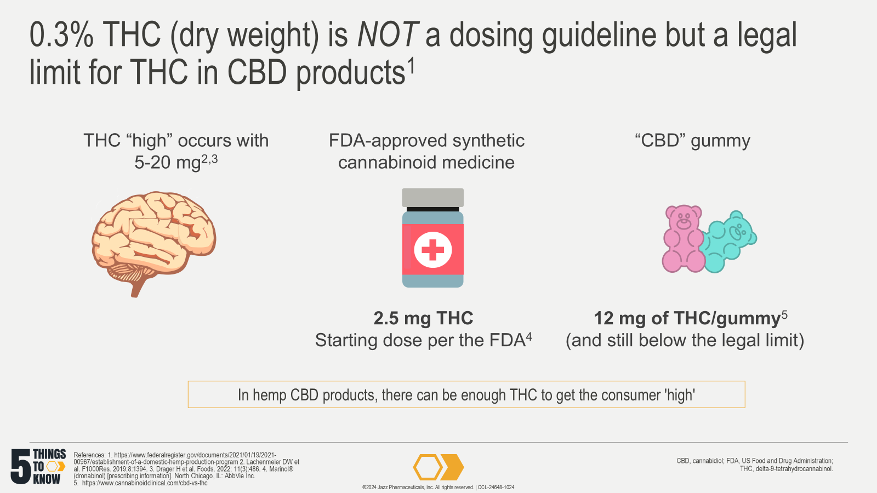
Notes:
References:
Department of Agriculture (USDA). Establishment of a Domestic Hemp Production Program, 7 CFR §990 (2021). Accessed 3 Dec 2021. https://www.federalregister.gov/documents/2021/01/19/2021-00967/establishment-of-a-domestic-hemp-production-program.
Lachenmeier DW, Habel S, Fischer B, et al. Are adverse effects of cannabidiol (CBD) products caused by tetrahydrocannabinol (THC) contamination? F1000Res. 2019;8(1394):1394. doi:10.12688/f1000research.19931.5
Dräger H, Barthlott I, Golombek P, Walch SG, Lachenmeier DW. Time Trends of Tetrahydrocannabinol (THC) in a 2008–2021 German National Survey of Hemp Food Products. Foods. 2022; 11(3):486. doi:10.3390/foods11030486
Marinol® (dronabinol) capsules, for oral use [prescribing information]. North Chicago, IL: AbbVie Inc. https://dailymed.nlm.nih.gov/dailymed/drugInfo.cfm?setid=d0efeeec-640d-43c3-8f0a-d31324a11c68
Jazz Pharmaceuticals. CBD & the 0.3% THC limit. https://www.cannabinoidclinical.com/cbd-vs-thc. 2023. Accessed Sep 2024.

Slide 22
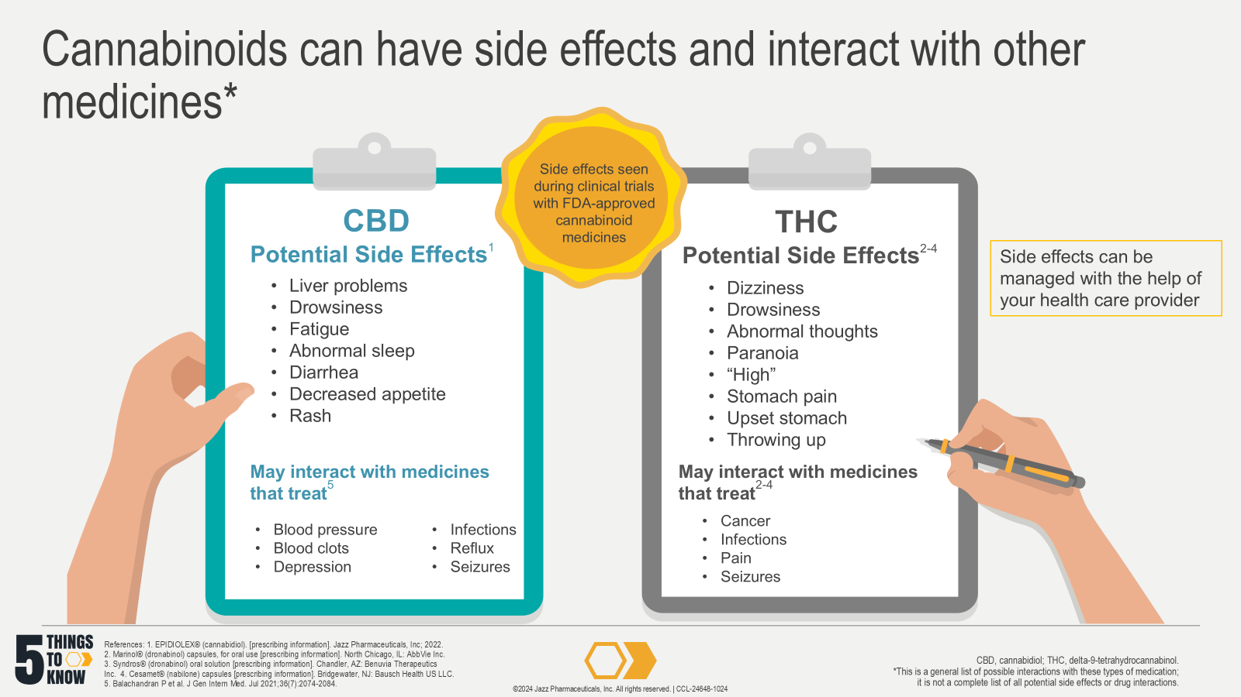
Notes:
Notes:
Cannabinoids are metabolized primarily by the liver:
CBD by CYP3A4 and CYP2C19¹
THC by CYP2C9 and CYP3A4²⁻⁴
These CYP enzymes are common routes for drug metabolism⁶
References:
EPIDIOLEX® (cannabidiol). [prescribing information]. Jazz Pharmaceuticals, Inc; 2022. Accessed October 5, 2022. https://pp.jazzpharma.com/pi/EPIDIOLEX.en.USPI.pdf
Marinol® (dronabinol) capsules, for oral use [prescribing information]. North Chicago, IL: AbbVie Inc. https://dailymed.nlm.nih.gov/dailymed/drugInfo.cfm?setid=d0efeeec-640d-43c3-8f0a-d31324a11c68
Syndros® (dronabinol) oral solution [prescribing information]. Chandler, AZ: Benuvia Therapeutics Inc. https://dailymed.nlm.nih.gov/dailymed/drugInfo.cfm?setid=a7801c70-995d-46a2-91ee-141ef427c6b5
Cesamet® (nabilone) capsules [prescribing information]. Bridgewater, NJ: Bausch Health US LLC. https://dailymed.nlm.nih.gov/dailymed/drugInfo.cfm?setid=83c7ac15-ece9-47de-b83c-d575544fa449
Balachandran P, Elsohly M, Hill KP. Cannabidiol Interactions with Medications, Illicit Substances, and Alcohol: A Comprehensive Review. J Gen Intern Med. Jul 2021;36(7):2074-2084. doi:10.1007/s11606-020-06504-8
Doohan PT. Cannabinoid Interactions with Cytochrome P450 Drug Metabolism: a Full-Spectrum Characterization. The AAPS Journal. 2021;23doi:10.1208/s12248-021-00616-7 [Notes only]

Slide 23
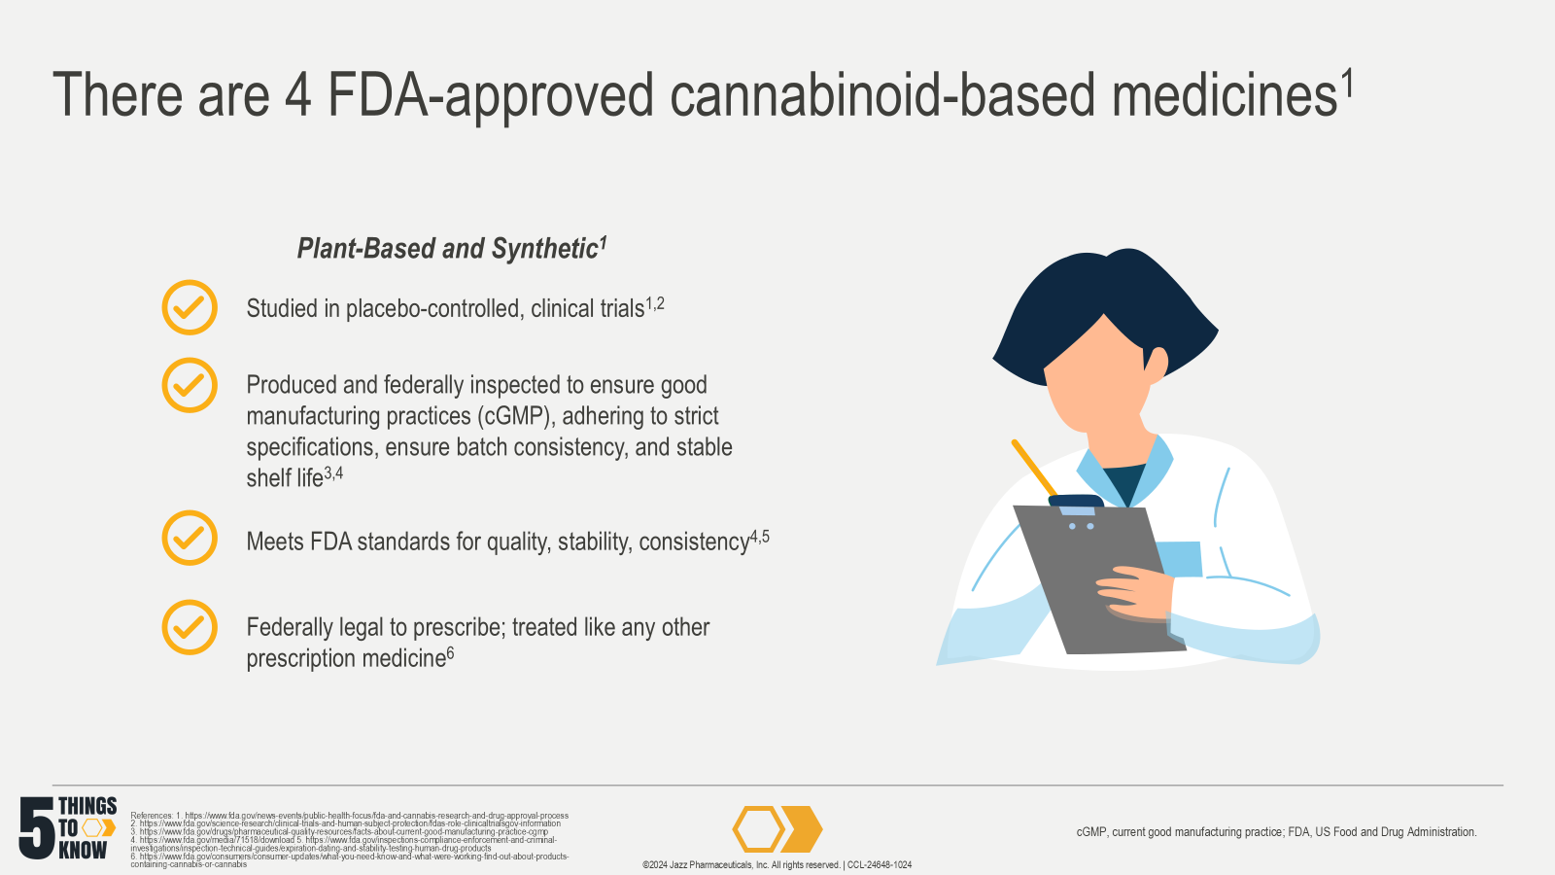
Notes:
References:
US Food and Drug Administration. FDA and Cannabis: Research and Drug Approval Process. Updated Feb 24, 2023. Accessed Oct 2, 2024. https://www.fda.gov/news-events/public-health-focus/fda-and-cannabis-research-and-drug-approval-process
US Food and Drug Administration. Placebos and Blinding in Randomized Controlled Cancer Trials for Drug and Biological Products. 2019. Accessed Oct 1, 2024. https://www.fda.gov/media/130326/download
US Food and Drug Administration. Facts About the Current Good Manufacturing Practices (CGMPs). Updated Feb 16, 2024. Accessed Oct 1, 2024. https://www.fda.gov/drugs/pharmaceutical-quality-resources/facts-about-current-good-manufacturing-practices-cgmps
US Food and Drug Administration. Q7 Good Manufacturing Practice Guidance for Active Pharmaceutical Ingredients Guidance for Industry. 2016. Accessed Dec 3, 2021. https://www.fda.gov/media/71518/download
US Food and Drug Administration. Expiration Dating and Stability Testing for Human Drug Products. Updated Nov 7, 2014. Accessed Dec 6, 2021. https://www.fda.gov/inspections-compliance-enforcement-and-criminal-investigations/inspection-technical-guides/expiration-dating-and-stability-testing-human-drug-products
US Food and Drug Administration. FDA Regulation and Consideration of Cannabis and Cannabis-derived Compounds. Updated Feb 7, 2023. Accessed October 14, 2024. https://www.fda.gov/drugs/cder-small-business-industry-assistance-sbia/fda-regulation-and-quality-considerations-cannabis-and-cannabis-derived-compounds

Slide 24
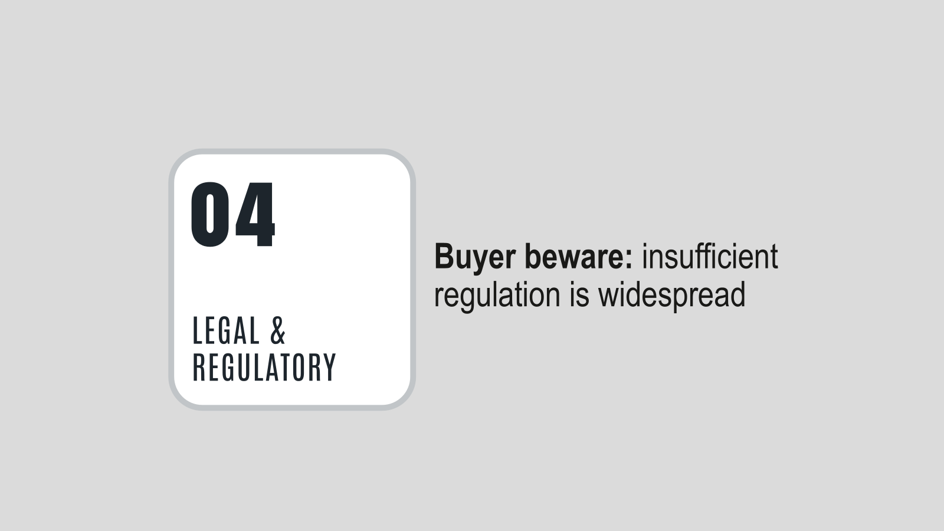

Slide 25
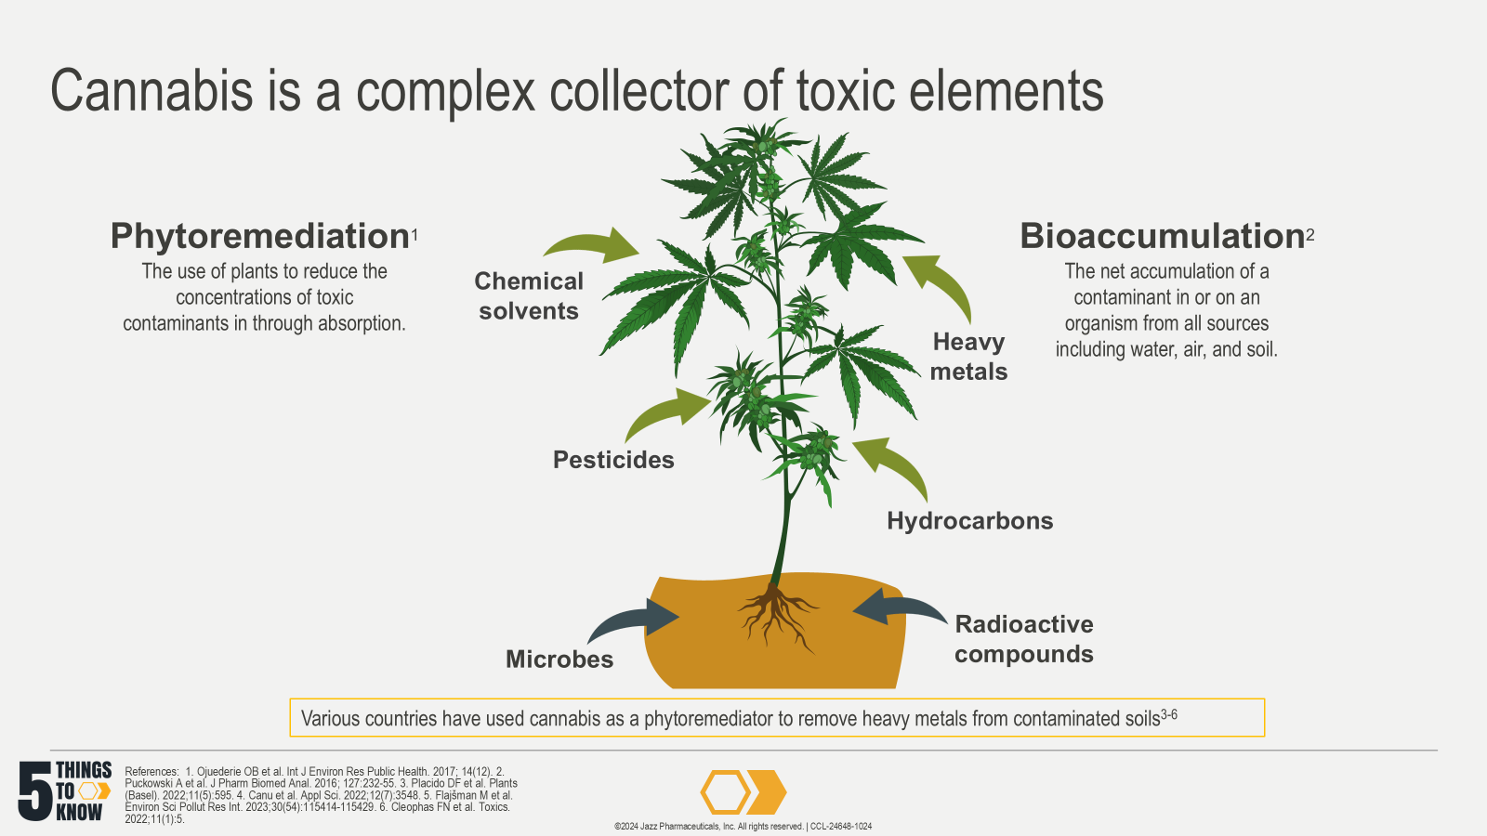
Notes:
References:
Ojuederie OB, Babalola OO. Microbial and Plant-Assisted Bioremediation of Heavy Metal Polluted Environments: A Review. Int J Environ Res Public Health. Dec 4 2017;14(12)doi:10.3390/ijerph14121504
Puckowski A, Mioduszewska K, Lukaszewicz P, et al. Bioaccumulation and analytics of pharmaceutical residues in the environment: A review. J Pharm Biomed Anal. Aug 5 2016;127:232-55. doi:10.1016/j.jpba.2016.02.049
Placido DF, Lee CC. Potential of Industrial Hemp for Phytoremediation of Heavy Metals. Plants (Basel). 2022;11(5):595. Published 2022 Feb 23. doi:10.3390/plants11050595
Canu, M.; Mulè, P.; Spanu, E.; Fanni, S.; Marrone, A.; Carboni, G. Hemp Cultivation in Soils Polluted by Cd, Pb and Zn in the Mediterranean Area: Sites Characterization and Phytoremediation in Real Scale Settlement. Appl. Sci. 2022, 12, 3548. https://doi.org/10.3390/ app12073548
Flajšman M, Košmelj K, Grčman H, Ačko DK, Zupan M. Industrial hemp (Cannabis sativa L.)-a valuable alternative crop for growing in agricultural soils contaminated with heavy metals. Environ Sci Pollut Res Int. 2023;30(54):115414-115429. doi:10.1007/s11356-023-30474-z
Cleophas FN, Zahari NZ, Murugayah P, Rahim SA, Mohd Yatim AN. Phytoremediation: A Novel Approach of Bast Fiber Plants (Hemp, Kenaf, Jute and Flax) for Heavy Metals Decontamination in Soil-Review. Toxics. 2022;11(1):5. Published 2022 Dec 20. doi:10.3390/toxics11010005

Slide 26
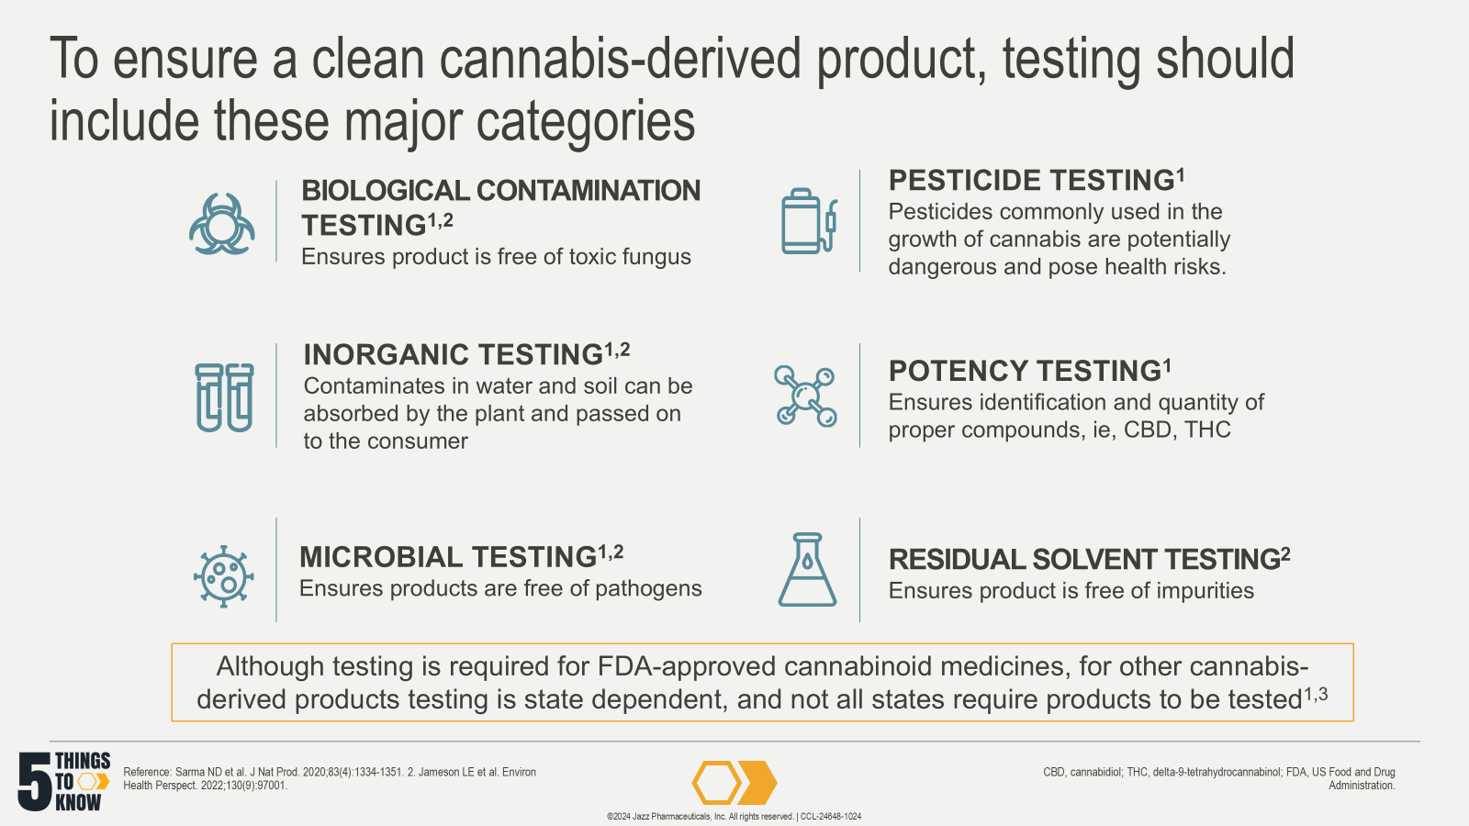
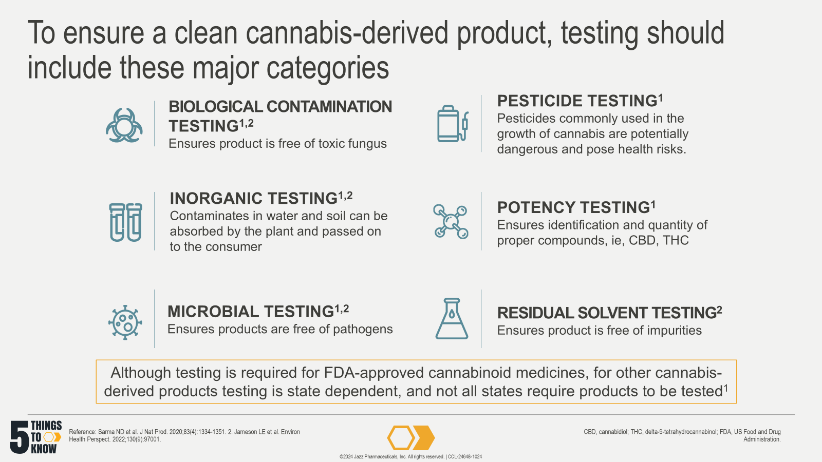
Notes:
References:
Sarma ND, Waye A, ElSohly MA, et al. Cannabis Inflorescence for Medical Purposes: USP Considerations for Quality Attributes. J Nat Prod. 2020;83(4):1334-1351. doi:10.1021/acs.jnatprod.9b01200
Jameson LE, Conrow KD, Pinkhasova DV, et al. Comparison of State-Level Regulations for Cannabis Contaminants and Implications for Public Health. Environ Health Perspect. 2022;130(9):97001. doi:10.1289/EHP11206
US Food and Drug Administration. FDA Regulation and Consideration of Cannabis and Cannabis-derived Compounds. Updated Feb 7, 2023. Accessed October 14, 2024. https://www.fda.gov/drugs/cder-small-business-industry-assistance-sbia/fda-regulation-and-quality-considerations-cannabis-and-cannabis-derived-compounds

Slide 27
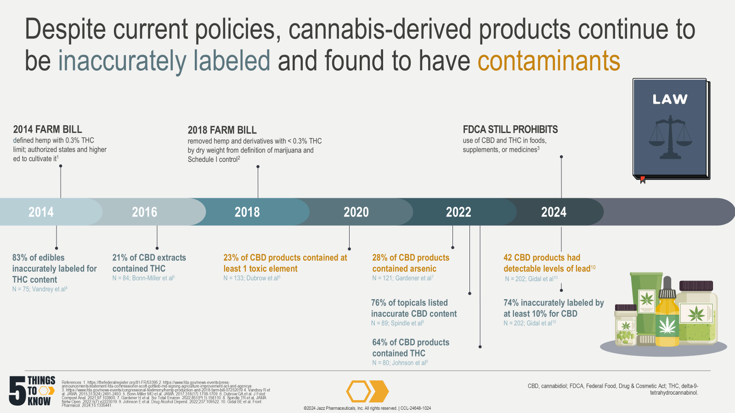
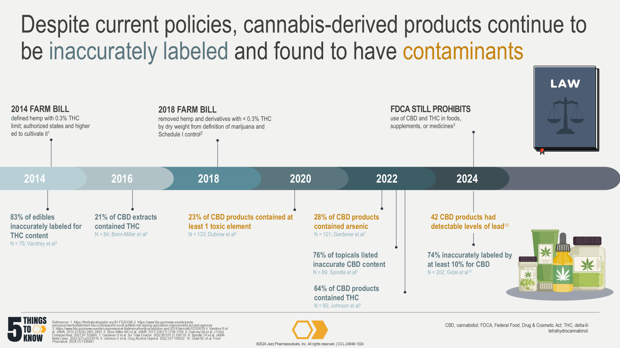
Notes:
References:
Federal Register. 81 FR §53395 - Statement of Principles on Industrial Hemp. Accessed December 13, 2022. https://thefederalregister.org/81-FR/53395
Hemp production and 2018 Farm Bill. US Food and Drug Administration. Updated July 2019. Accessed March 3, 2021. https://www.fda.gov/news-events/congressional-testimony/hemp-production-and-2018-farm-bill-07252019
Statement from FDA Commissioner Scott Gottlieb, M.D., on signing of the Agriculture Improvement Act and the agency’s regulation of products containing cannabis and cannabis-derived compounds. US Food and Drug Administration. Updated December 2018. Accessed March 15, 2021. https://www.fda.gov/news-events/press-announcements/statement-fda-commissioner-scott-gottlieb-md-signing-agriculture-improvement-act-and-agencys
Vandrey R, Raber JC, Raber ME, Douglass B, Miller C, Bonn-Miller MO. Cannabinoid Dose and Label Accuracy in Edible Medical Cannabis Products [published correction appears in JAMA. 2015 Jul 14;314(2):188]. JAMA. 2015;313(24):2491-2493. doi:10.1001/jama.2015.6613
Bonn-Miller MO, Loflin MJE, Thomas BF, Marcu JP, Hyke T, Vandrey R. Labeling Accuracy of Cannabidiol Extracts Sold Online. JAMA. 2017;318(17):1708-1709. doi:10.1001/jama.2017.11909
Dubrow GA, Pawar RS, Srigley C, et al. A survey of cannabinoids and toxic elements in hemp-derived products from the United States marketplace. J Food Compost Anal. 2021;97:103800. doi: 10.1016/j.jfca.2020.103800.
Gardener H, Wallin C, Bowen J. Heavy metal and phthalate contamination and labeling integrity in a large sample of US commercially available cannabidiol (CBD) products. Sci Total Environ. 2022;851(Pt 1):158110. doi: 10.1016/j.scitotenv.2022.158110.
Spindle TR, Sholler DJ, Cone EJ, et al. Cannabinoid Content and Label Accuracy of Hemp-Derived Topical Products Available Online and at National Retail Stores. JAMA Netw Open. 2022;5(7):e2223019. doi: 10.1001/jamanetworkopen.2022.23019
Johnson E, Kilgore M, Babalonis S. Cannabidiol (CBD) product contamination: Quantitative analysis of Δ9-tetrahydrocannabinol (Δ9-THC) concentrations found in commercially available CBD products. Drug Alcohol Depend. 2022;237:109522. doi: 10.1016/j.drugalcdep.2022.109522
Gidal BE, Vandrey R, Wallin C, et al. Product labeling accuracy and contamination analysis of commercially available cannabidiol product samples. Front Pharmacol. 2024;15:1335441. doi: 10.3389/fphar.2024.1335441

Slide 28
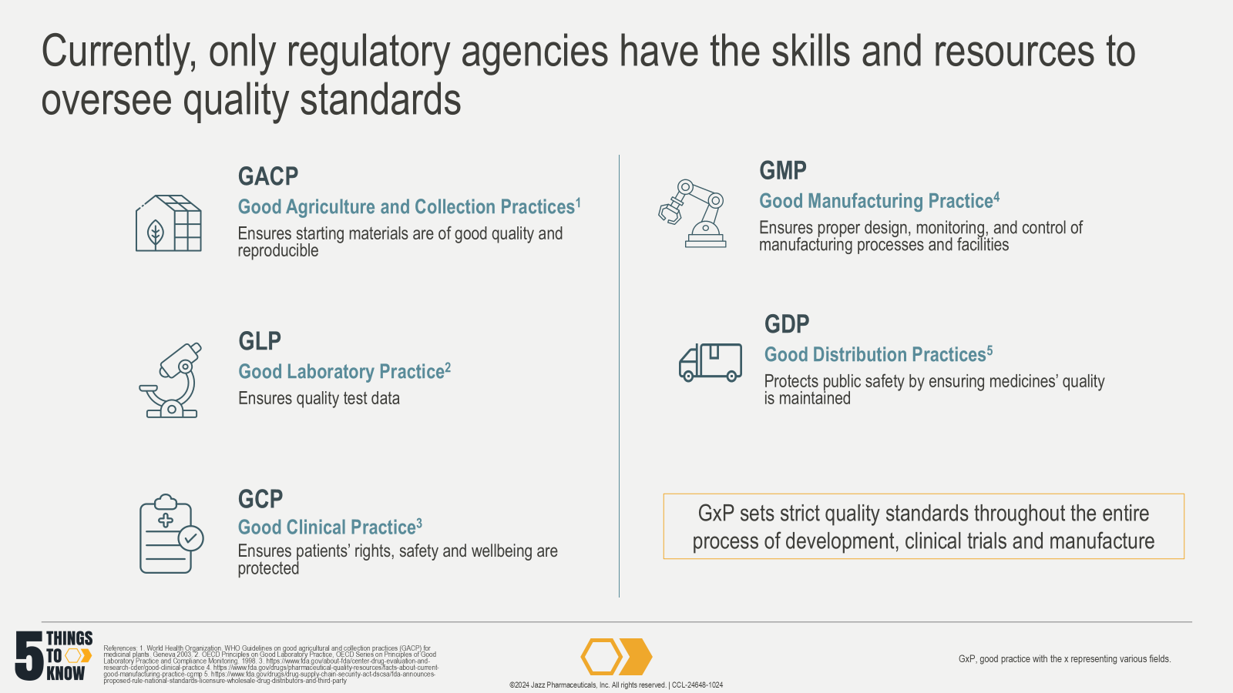
Notes:
References:
World Health Organization. WHO Guidelines on good agricultural and collection practices (GACP) for medicinal plants. Geneva 2003.
OECD (1998), OECD Principles on Good Laboratory Practice, OECD Series on Principles of Good Laboratory Practice and Compliance Monitoring, No. 1, OECD Publishing, Paris, https://doi.org/10.1787/9789264078536-en
US Food and Drug Administration. Good Clinical Practice. Updated Dec 11, 2019. Accessed Oct. 2, 2024. https://www.fda.gov/about-fda/center-drug-evaluation-and-research-cder/good-clinical-practice
US Food and Drug Administration. Facts About the Current Good Manufacturing Practice (cGMP). Updated Feb 16, 2024. Accessed Oct 2, 2024. https://www.fda.gov/drugs/pharmaceutical-quality-resources/facts-about-current-good-manufacturing-practice-cgmp
US Food and Drug Administration. FDA Announces proposed rule: National Standards for Licensure of Wholesale Drug Distributors and Third-Party Logistics Providers. Updated June 22, 2022. Accessed Oct 2, 2024. https://www.fda.gov/drugs/drug-supply-chain-security-act-dscsa/fda-announces-proposed-rule-national-standards-licensure-wholesale-drug-distributors-and-third-party

Slide 29
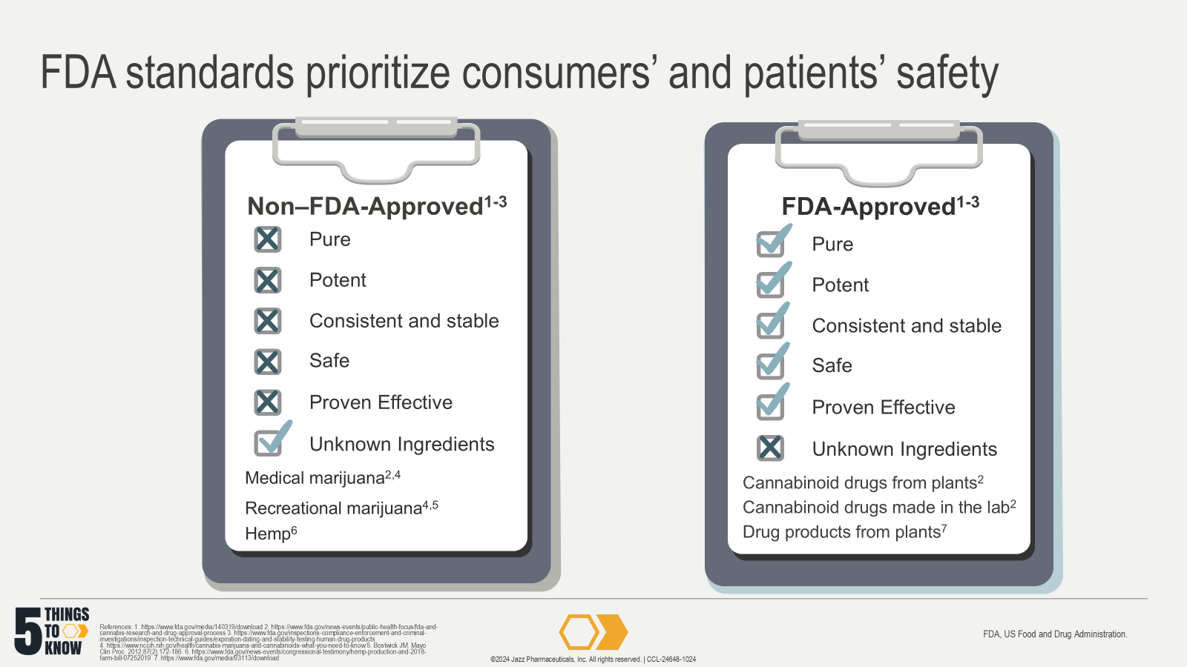
Notes:
References:
US Food and Drug Administration. Cannabis and cannabis-derived compounds: quality considerations for clinical research: guidance for industry. 2020. Accessed March 3, 2021. https://www.fda.gov/media/140319/download
US Food and Drug Administration. FDA and Cannabis: Research and Drug Approval Process. Updated Feb 24, 2023. Accessed Oct 1, 2024. https://www.fda.gov/news-events/public-health-focus/fda-and-cannabis-research-and-drug-approval-process.
US Food and Drug Administration. Expiration Dating and Stability Testing for Human Drug Products. Nov 7, 2014. Accessed Sept 30, 2024. https://www.fda.gov/inspections-compliance-enforcement-and-criminal-investigations/inspection-technical-guides/expiration-dating-and-stability-testing-human-drug-products
National Institute of Health. Cannabis (marijuana) and cannabinoids: what you need to know. Updated November 2019. Accessed February 9, 2023. https://www.nccih.nih.gov/health/cannabis-marijuana-and-cannabinoids-what-you-need-to-know
Bostwick JM. Blurred boundaries: the therapeutics and politics of medical marijuana. Mayo Clin Proc. 2012;87(2):172-186. doi:10.1016/j.mayocp.2011.10.003
US Food and Drug Administration. Hemp Production and the 2018 Farm Bill. Updated July 25, 2019. Accessed October 10, 2024. https://www.fda.gov/news-events/congressional-testimony/hemp-production-and-2018-farm-bill-07252019
US Food and Drug Administration. Botanical Drug Development Guidance for Industry. FDA. Updated Aug 29, 2024. Accessed February 9, 2023. https://www.fda.gov/media/93113/download

Slide 30
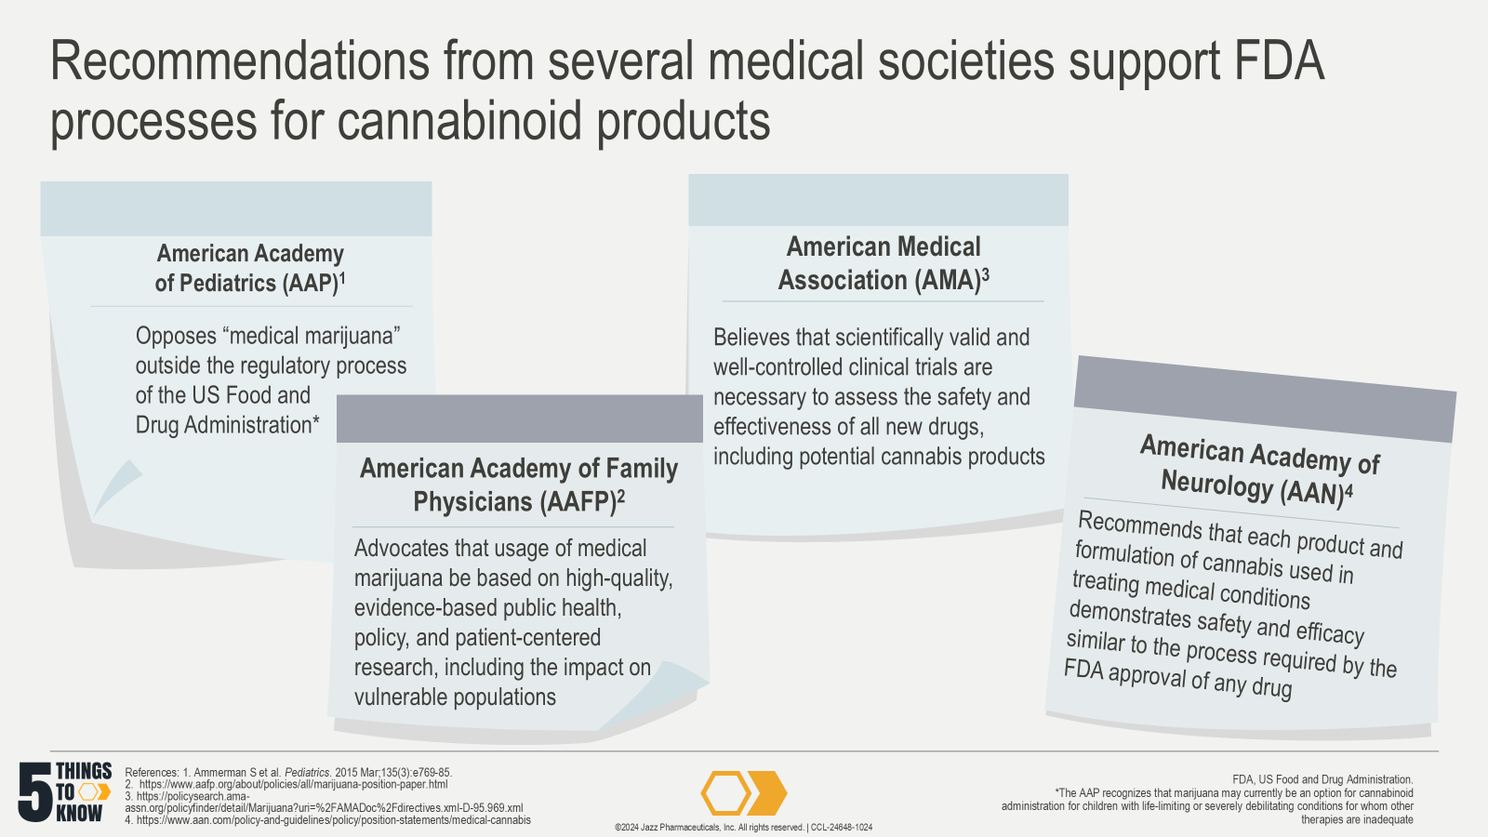
Notes:
Reference:
Ammerman S, Ryan S, Adelman WP; Committee on Substance Abuse, the Committee on Adolescence. The impact of marijuana policies on youth: clinical, research, and legal update. Pediatrics. 2015 Mar;135(3):e769-85. doi: 10.1542/peds.2014-4147.
American Academy of Family Physicians. Marijuana and Cannabinoids: Health, Research and Regulatory Considerations (Position Paper). July 2019. Accessed September 23, 2024. https://www.aafp.org/about/policies/all/marijuana-position-paper.html
American Medical Association. AMA: Cannabis Legalization for Medicinal Use D-95.969. Updated 2023, Accessed Sep 16, 2024. https://policysearch.ama-assn.org/policyfinder/detail/Marijuana?uri=%2FAMADoc%2Fdirectives.xml-D-95.969.xml
American Academy of Neurology. AAN position: use of medical cannabis for neurologic disorders. Updated Sept 9, 2020, 2020. Accessed Sep 16, 2024. https://www.aan.com/policy-and-guidelines/policy/position-statements/medical-cannabis/

Slide 31


Slide 32
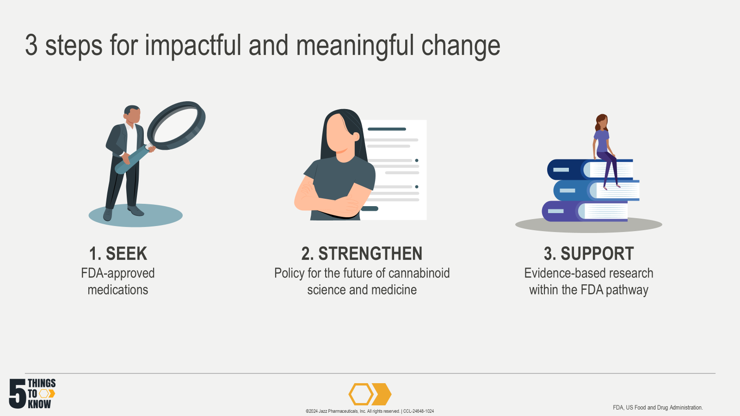

Slide 33
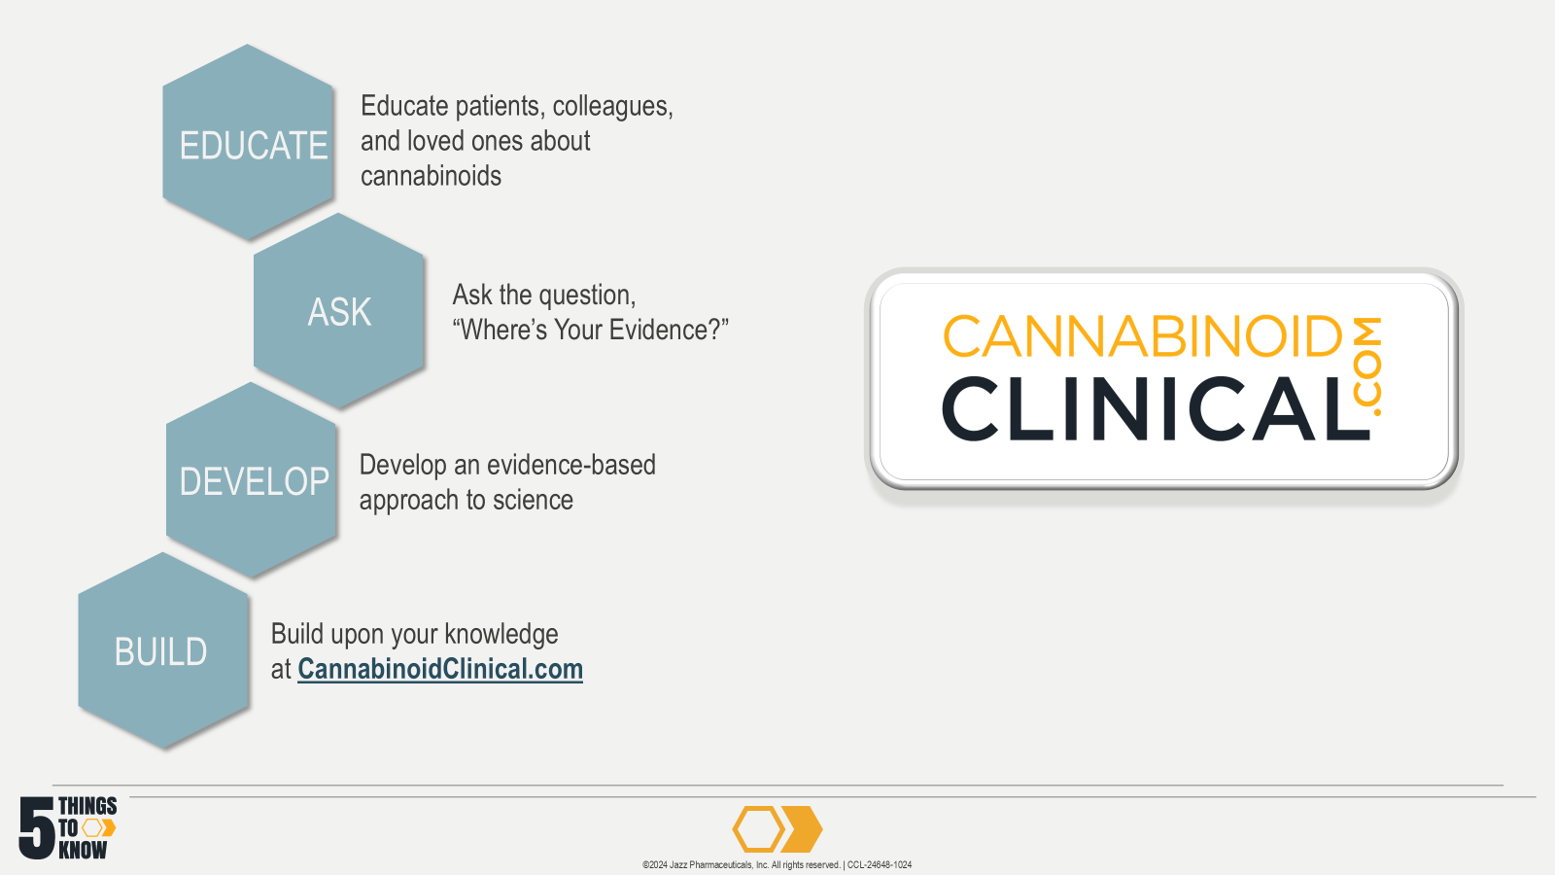

Slide 34
